Slide 1
Hashtag Recommendation Using Attention-Based Convolutional Neural Network
Sami Ullah (2017206355)
INFOSEC Lab

Slide 2
Problem Statement:
Hashtag are labels or metadata tags, which makes it easier to find the messages with specific theme. This paper is about hashtag recommendation for microblogs.
Being inspired by convolutional neural networks (CNN), author recommendation system adopts CNN.
In previous methods for hashtag recommendation, the effectiveness of trigger words (most relevant) have been demonstrated.
So author adopts attention model in CNN to incorporate trigger words.
The relative improvement over the state-of-the-art methods is around 9.4% in F1-score.

Slide 3
Agenda:
Brief Background
CNN brief introduction
Attention Model
The Proposed Model
Local Attention Channel
Global Attention Model
Training and Recommendation Hypothesis
Experiments and results

Slide 4
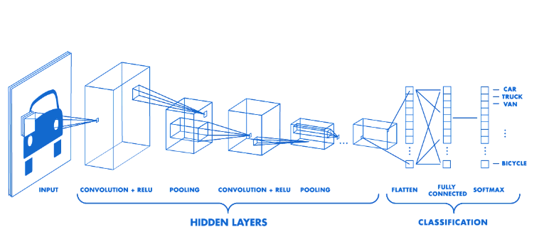
Brief Background:
Typical CNN
Different architectures are possible based on number of each major layers.

Slide 5
Convolution

Slide 6
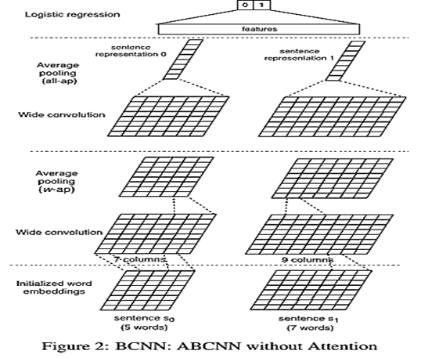
Bi-CNN
The core architecture for using Attention Model in CNN.
Two weight sharing CNN
Each processing one of two sentences
Final layer solves the sentence pairing task.

Slide 7
Bi-CNN
Input layer
Each word is represented as d0-dimensional precomputed word2vec embedding, d0 = 300
Convolution layer
pi = tanh(W · ci + b)
Average Polling layer
Output feature map of the last convolution layer, do column-wise averaging over all columns
Non-output layers, do column-wise averaging over windows of w consecutive column
Output Layer
Simple logistic regression for classification tasks

Slide 8
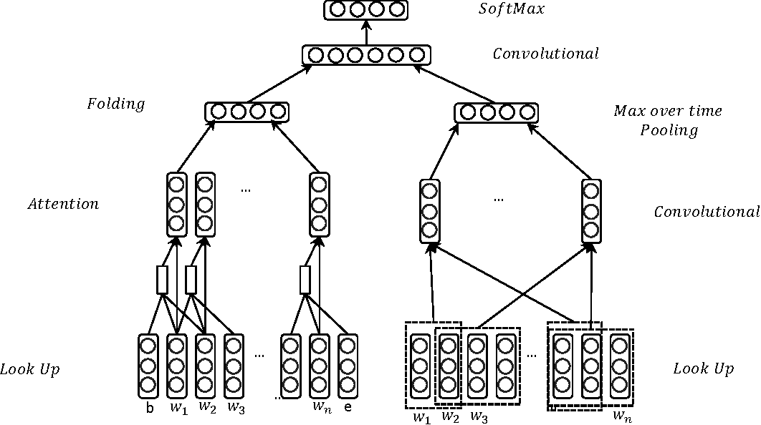
The Proposed Model
Multi-class classification

Slide 9

Local Attention channel
Model the attention problem as decision process.
A microblog of length n is represented with $w_{1:n}$, which is concatenation of words $w_{1}…w_{n}$
Score of the central word s(2i+h-1)/2 = g($M^{l}$ * $w_{i:i+h}$ + b)
Triggers words are extracted based on their score. ${w′}_{i}=\left\{\begin{aligned}&w_{i} if w_{i}>η \\ &0 if{ w}_{i}≤ η\end{aligned}\right.$ $0≤i<n$
$η is threshold and$ $η= δ.\min\left\{s\right\}+\left(1−δ\right).\max\left\{s\right\}$ $where δ ε [0,1]$

Slide 10

Local Attention channel
After local attention layer, extracted trigger words are input to folding layer. $z=g\left(M^{l} ∗folding\left(w^{′}\right)+b\right)$
where w’ are trigger words.
Folding is the sum operation for each dimension of all the trigger words. $f_{i}= Σ_{j}{ w′}_{j,i}$
The final output of the local attention channel is a fixed length vector.

Slide 11

Global channel
In the global channel, a typical CNN architecture is used to model the whole microblog, using a filter (a weight matrix) $M^{g} ε R^{l x d}$ where l is filter size
E.g a feature $z_{i}$generated from filter of size l operated on words $z_{i}$ = g($M^{g}$ * $w_{i:i+l−1}$ + b)
This filter is operated on all combinations of the words to produce a feature map as follows z = [$z_{1},z_{2}$, ... , $z_{n−l+1}$]

Slide 12
Global channel
In the pooling layer, a max-overtime pooling operation is applied over feature map z to produce a feature for this filter.
To obtain multiple features, multiple filters with varying window sizes are used in convolution layer.
After getting multiple feature matrix, a tanh (activation function) is applied to the pooled matrix.
The final output of global channel is also a fixed length vector; which represents the embeddings of the input microblog m.

Slide 13
Fully Connected Layer
FC is general convolution layer with multiple feature maps.
Output form local attention channel and global channel is input to FC, to combine the outputs from both ends.
Output form the FC is regarded as embedding of the microblog from the proposed network.

Slide 14
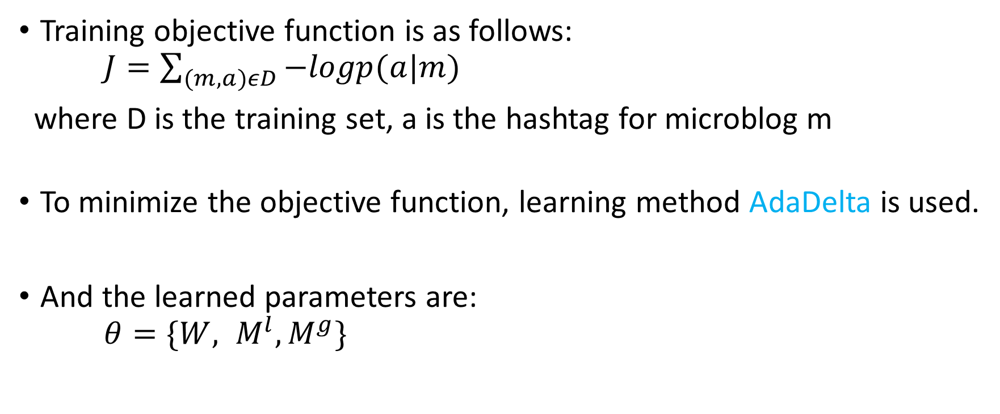
Training
Training objective function is as follows: $J=\sum_{(m,a)εD}{−logp(a|m)}$
where D is the training set, a is the hashtag for microblog m
To minimize the objective function, learning method AdaDelta is used.
And the learned parameters are: $θ=\{W, M^{l}, M^{g}\}$

Slide 15
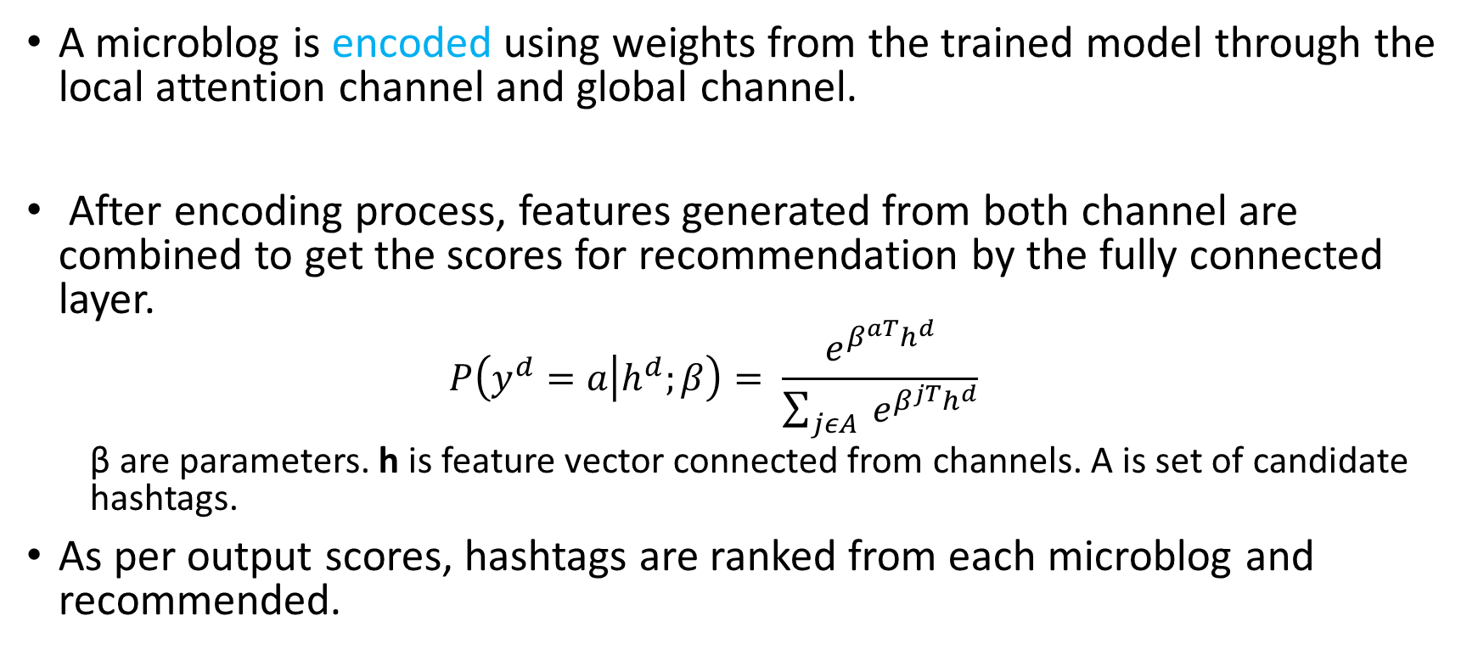
Hashtag Recommendation
A microblog is encoded using weights from the trained model through the local attention channel and global channel.
After encoding process, features generated from both channel are combined to get the scores for recommendation by the fully connected layer.
$$P\left(y^{d}=a | h^{d};β\right)= \frac{e^{β^{aT}h^{d}}}{\sum_{jεA}{ e^{β^{jT}h^{d}}}}$$
β are parameters. h is feature vector connected from channels. A is set of candidate hashtags.
As per output scores, hashtags are ranked from each microblog and recommended.

Slide 16
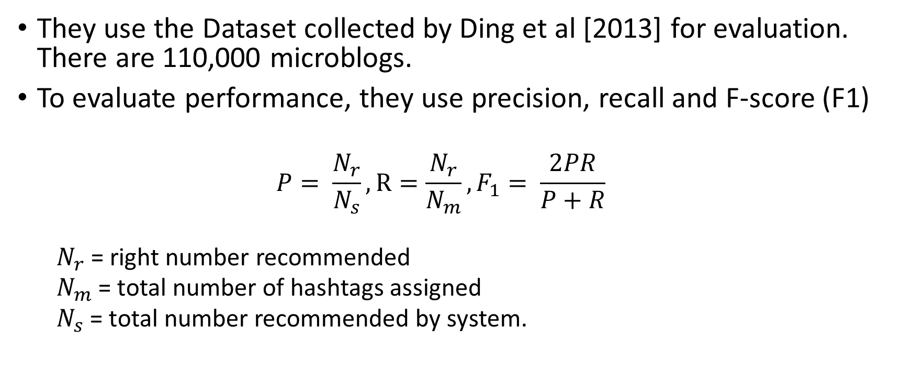
Experiments
They use the Dataset collected by Ding et al [2013] for evaluation. There are 110,000 microblogs.
To evaluate performance, they use precision, recall and F-score (F1)
$$P= \frac{N_{r}}{N_{s}}, R=\frac{N_{r}}{N_{m}}, F_{1}= \frac{2PR}{P+R}$$
$N_{r}$ = right number recommended
$N_{m}$ = total number of hashtags assigned
$N_{s}$ = total number recommended by system.

Slide 17
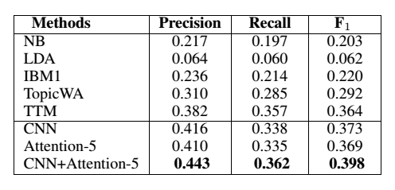
Results

Slide 18
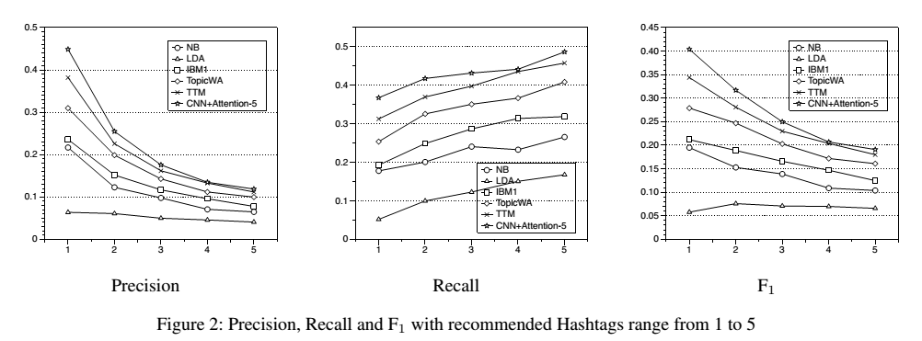
Results

Slide 19
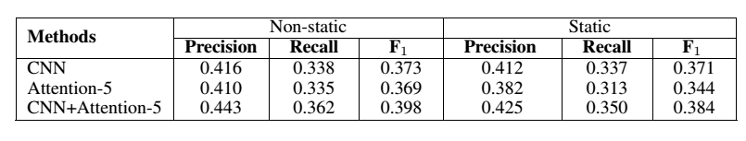
Static vs non-static models

Slide 20
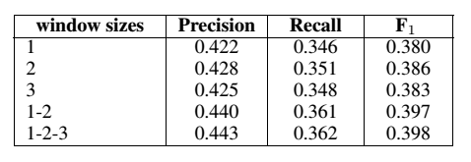
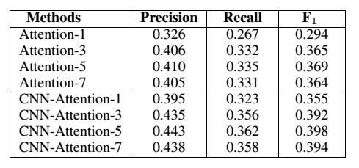
Performance on various window sizes

Slide 21
Q&A

